Slide 1

Requirement Engineering and Software Design
TTTE6104
Software Engineering Paradigm

Slide 2
Objectives
understand the concepts of user and system requirements and why these requirements should be written in different ways;
understand the differences between functional and nonfunctional software requirements;
understand how requirements may be organized in a software requirements document;
understand the principal requirements engineering activities of elicitation, analysis and validation, and the relationships between these activities;
understand why requirements management is necessary and how it supports other requirements engineering activities.

Slide 3
Contents
Functional and non-functional requirements
The software requirements document
Requirements specification
Requirements engineering processes
Requirements elicitation and analysis
Requirements validation
Requirements management

Slide 4
Requirements
The requirements for a system are the descriptions of what the system should do— the services that it provides and the constraints on its operation.
Reflect the needs of customers for a system that serves a certain purpose such as controlling a device, placing an order, or finding information.
Simply a high-level, abstract statement of a service that a sys- tem should provide or a constraint on a system, Or
A detailed, formal definition of a system function

Slide 5
User requirements
Statements, in a natural language plus diagrams, of what services the system is expected to provide to system users and the constraints under which it must operate.
Write user requirements in natural language, with simple tables, forms, and intuitive diagrams.

Slide 6
System requirements
more detailed descriptions of the software system’s functions, services, and operational constraints.
The system requirements document (sometimes called a functional specification) should define exactly what is to be implemented.
It may be part of the contract between the system buyer and the software developers.

Slide 7
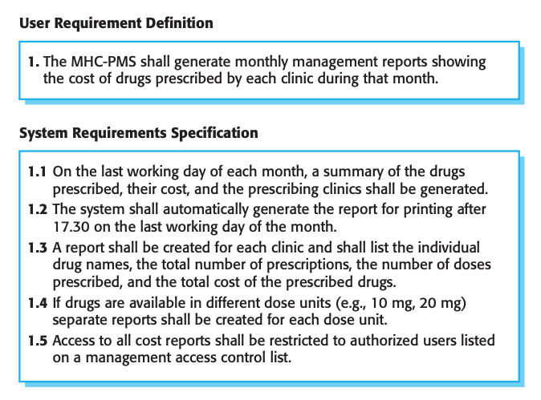
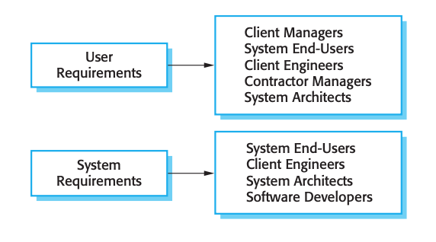
User and system requirements

Slide 8
Requirements Engineering (RE)
The process of finding out, analyzing, documenting and checking these services and constraints.

Slide 9
Functional and non-functional requirements
Functional requirements
  Statements of services the system should provide, how the system should react to particular inputs, and how the system should behave in particular situations.
  May also explicitly state what the system should not do.
Non-functional requirements
  These are constraints on the services or functions offered by the system. They include timing constraints, constraints on the development process, and constraints imposed by standards.
  Often apply to the system as a whole, rather than individual system features or services.

Slide 10
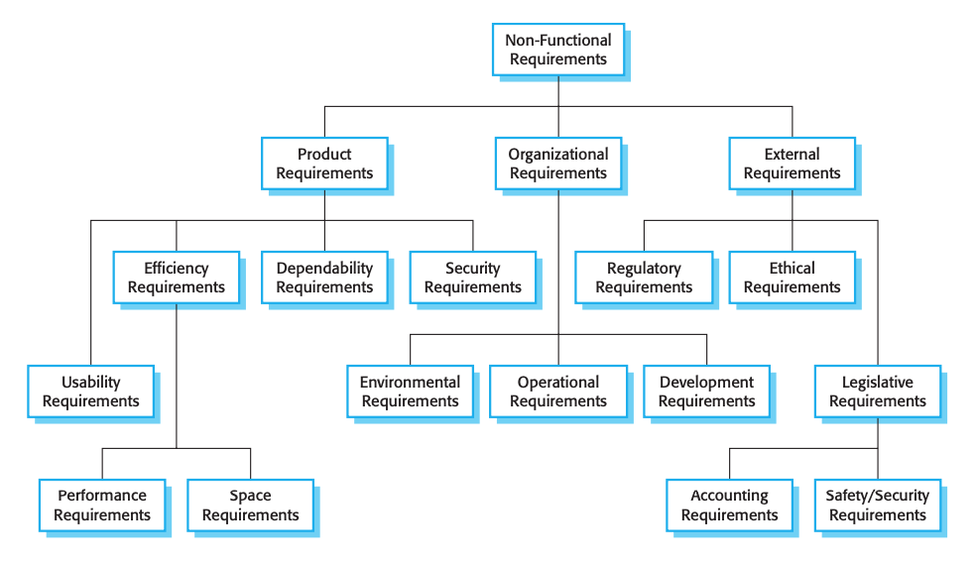
Types of non-functional requirement

Slide 11
Class Activity: Identifying Functional and Non-Functional Requirements
Form groups of 3-4 students.Select one of the following real-world systems:Online shopping platform (e.g., Amazon, Lazada)
  Food delivery app (e.g., Grab, UberEats)
  Online banking system (e.g., Maybank2u, CIMB Clicks)
  Ride-hailing app (e.g., Grab, Lyft)
For your chosen system, identify:
  2 Functional requirements: Describe services the system should provide or how it should react in certain situations.
  2 Non-functional requirements: Describe constraints related to performance, security, usability, etc., that apply to the system.
Prepare a brief 5-minute presentation to share your examples with the class.

Slide 12
The software requirements document
Sometimes called the software requirements specification or SRS
An official statement of what the system developers should implement.
It should include both the user requirements for a system and a detailed specification of the system requirements.
Essential when an outside contractor is developing the software system.

Slide 13
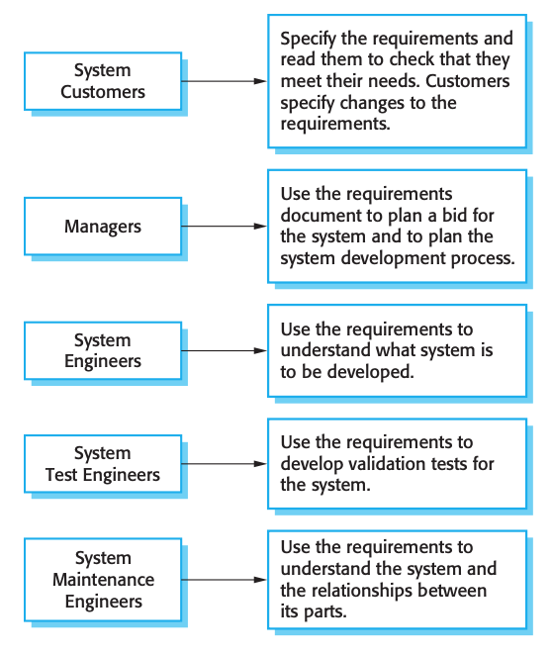
Users of a requirements document

Slide 14
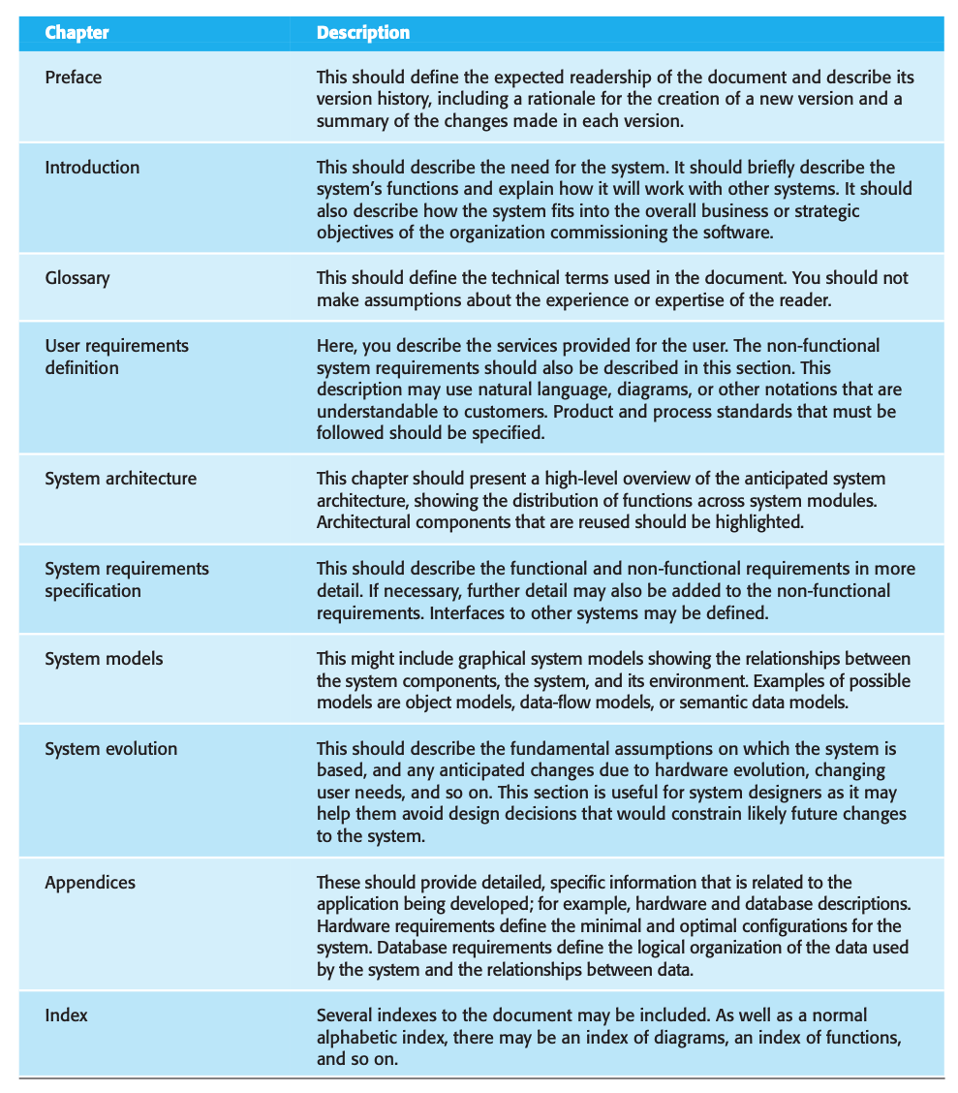
The structure of a requirements document

Slide 15
Requirements specification
Process of writing down the user and system requirements in a requirements document.
Should be clear, unambiguous, easy to understand, complete, and consistent.
Should not include details of the system architecture or design
User requirements - describe the functional and non- functional requirements so that they are understandable by system users who don’t have detailed technical knowledge
System requirements - describe the external behavior of the system and its operational constraints.

Slide 16
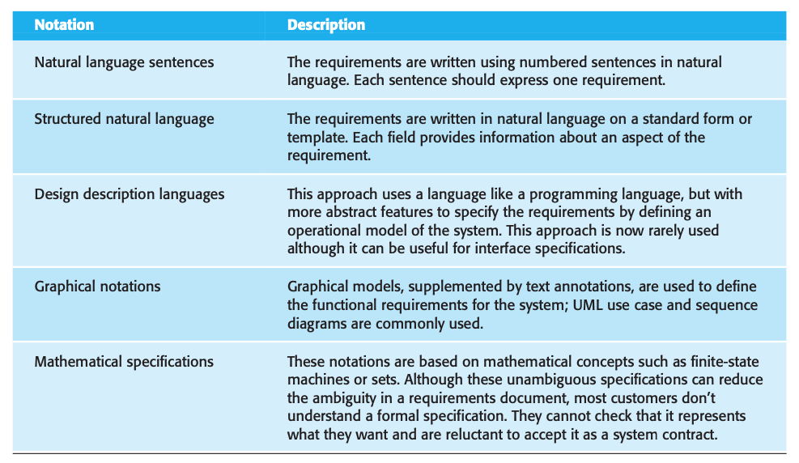
Ways of writing a system requirements specification

Slide 17
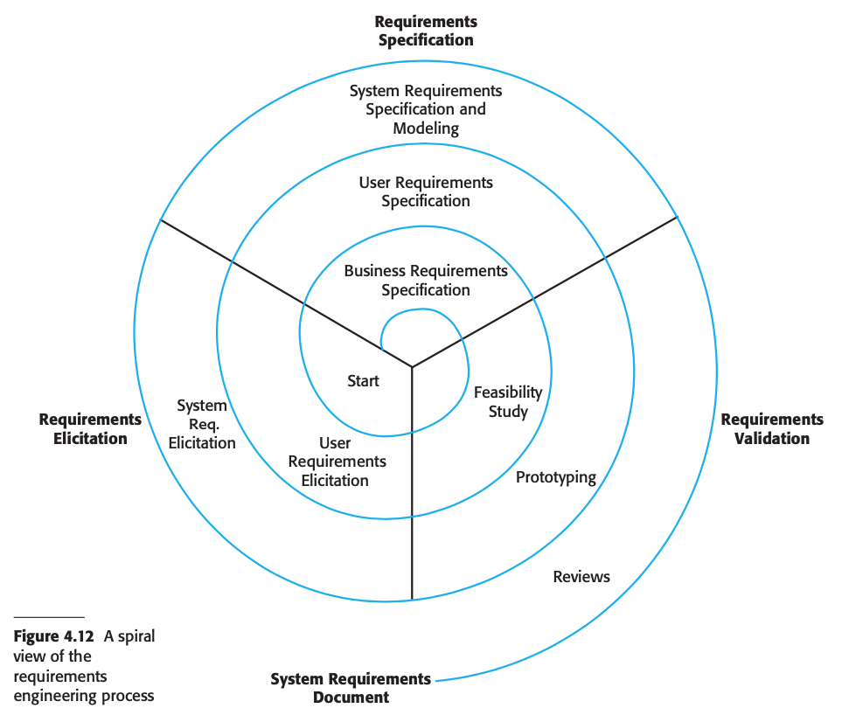
A spiral view of the requirements engineering process
Discussion Question:
In the spiral view of the requirements engineering process, requirements are gathered and refined through multiple iterations. Can you explain how this spiral model works and why it is beneficial for managing requirements in complex software projects? What are the key stages involved in each iteration?

Slide 18
Requirements engineering processes
Include four high-level activities.
Feasibility study - Focus on assessing if the system is useful to the business
elicitation and analysis - Discovering requirements
Specification - Converting these requirements into some standard form
Validation - Checking that the requirements define the system that the customer wants

Slide 19
Requirements elicitation and analysis
Software engineers work with customers and system end-users to find out about the application domain, what services the system should provide, the required performance of the system, hardware constraints, and so on.
The process activities are:
  Requirements discovery
  Requirements classification and organization
  Requirements prioritization and negotiation
  Requirements specification

Slide 20
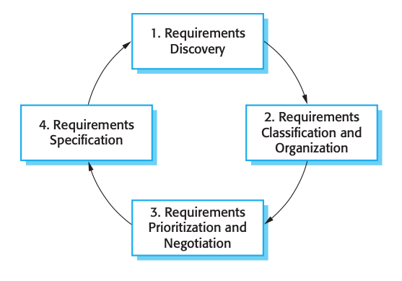
The requirements elicitation and analysis process
Iterative process

Slide 21
Techniques for Requirements Discovery
Interviews
Scenarios - starts with an outline of the interaction. During the elicitation process, details are added to this to create a complete description of that interaction.
Use cases - a fundamental feature of the unified modeling language
Ethnography - an observational technique that can be used to understand operational processes and help derive support requirements for these processes.

Slide 22
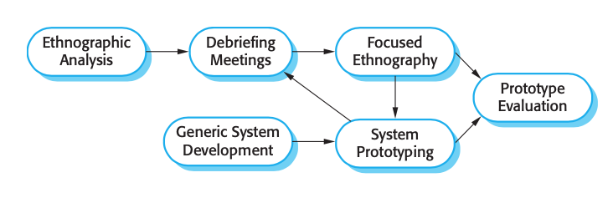
Ethnography and prototyping for requirements analysis

Slide 23
Eliciting and understanding requirements from system stakeholders is a difficult process for several reasons
Stakeholders often don’t know what they want from a computer system except in the most general terms; they may find it difficult to articulate what they want the system to do; they may make unrealistic demands because they don’t know what is and isn’t feasible.
Stakeholders in a system naturally express requirements in their own terms and with implicit knowledge of their own work. Requirements engineers, without experience in the customer’s domain, may not understand these requirements.
Different stakeholders have different requirements and they may express these in different ways. Requirements engineers have to discover all potential sources of requirements and discover commonalities and conflict.
Political factors may influence the requirements of a system. Managers may demand specific system requirements because these will allow them to increase their influence in the organization.
The economic and business environment in which the analysis takes place is dynamic. It inevitably changes during the analysis process. The importance of particular requirements may change. New requirements may emerge from new stakeholders who were not originally consulted.

Slide 24
Requirements validation
Process of checking that requirements actually define the system that the customer really wants
It is concerned with finding problems with the requirements.
It is important because errors in a requirements document can lead to extensive rework costs when these problems are discovered during development or after the system is in service
??
Has anyone experienced a situation where problems with the requirements were discovered during development or after the system was in service?
How did these issues affect the project, and what were the consequences in terms of time and cost?
??

Slide 25
Different types of checks
Validity checks - Further thought and analysis may identify additional or different functions that are required. Systems have diverse stakeholders with different needs.
Consistency checks - Requirements in the document should not conflict. There should not be contradictory constraints or different descriptions of the same system function.
Completeness checks - The requirements document should include requirements that define all functions and the constraints intended by the system user.
Realism checks - Using knowledge of existing technology, the requirements should be checked to ensure that they can actually be implemented.
Verifiability - To reduce the potential for dispute between customer and contractor, system requirements should always be written so that they are verifiable. Write a set of tests that can demonstrate that the delivered system meets each specified requirement.

Slide 26
Requirements Validation Techniques
Requirements reviews - The requirements are analyzed systematically by a team of reviewers who check for errors and inconsistencies.
Prototyping - In this approach to validation, an executable model of the system in question is demonstrated to end-users and customers. They can experiment with this model to see if it meets their real needs.
Test-case generation - Requirements should be testable. If the tests for the requirements are devised as part of the validation process, this often reveals requirements problems. If a test is difficult or impossible to design, this usually means that the requirements will be difficult to implement and should be reconsidered.

Slide 27
Class Activity: Researching Real-World Applications of Requirements Validation Techniques
Instructions:
Research and find a real-world case study, report, or article that demonstrates the use of one of the following requirements validation techniques:
  Requirements Reviews
  Prototyping
  Test-case Generation
In your research, focus on how the chosen technique was applied to a software development project and identify:
  The system or project being validated.
  The process followed in the application of the technique.
  The challenges faced or benefits gained from using the technique.
  Any issues found with the requirements and how they were resolved.
Summarize the findings:
  Briefly explain the case to the class in a 3-minute presentation.
  Share how this technique helped or hindered the success of the project.
Example Sources:
Software project case studies from journals or reputable websites.
White papers or technical reports from software companies.
Blogs or articles detailing experiences with requirements validation in real projects.

Slide 28
Requirements management
The requirements for large software systems are always changing.
The stakeholders’ understanding of the problem is constantly changing because:
  systems are usually developed to address problems that cannot be completely defined
  the software requirements are bound to be incomplete
The system requirements must then also evolve to reflect this changed problem view.

Slide 29
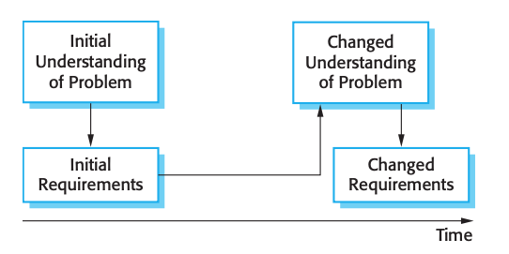
Requirements evolution

Slide 30
There are several reasons why change is inevitable
The business and technical environment of the system always changes after installation. New hardware may be introduced, it may be necessary to interface the system with other systems, business priorities may change (with consequent changes in the system support required), and new legislation and regulations may be introduced that the system must necessarily abide by.
The people who pay for a system and the users of that system are rarely the same people. System customers impose requirements because of organizational and budgetary constraints. These may conflict with end-user requirements and, after delivery, new features may have to be added for user support if the system is to meet its goals.
Large systems usually have a diverse user community, with many users having different requirements and priorities that may be conflicting or contradictory. The final system requirements are inevitably a compromise between them and, with experience, it is often discovered that the balance of support given to different users has to be changed.

Slide 31
Requirements management planning
Requirements identification - Each requirement must be uniquely identified so that it can be cross-referenced with other requirements and used in traceability assessments.
A change management process - This is the set of activities that assess the impact and cost of changes. I discuss this process in more detail in the following section.
Traceability policies - These policies define the relationships between each requirement and between the requirements and the system design that should be recorded. The traceability policy should also define how these records should be maintained.
Tool support - Requirements management involves the processing of large amounts of information about the requirements. Tools that may be used range from specialist requirements management systems to spreadsheets and simple database systems.

Slide 32
Requirements change management
Should be applied to all proposed changes to a system’s requirements after the requirements document has been approved.
Change management is essential because you need to decide if the benefits of implementing new requirements are justified by the costs of implementation.

Slide 33
Three principal stages to a change management process
Problem analysis and change specification - The process starts with an identified requirements problem. During this stage, the problem or the change proposal is analyzed to check that it is valid.
Change analysis and costing - The effect of the proposed change is assessed using traceability information and general knowledge of the system requirements. The cost of making the change is estimated both in terms of modifications to the requirements document and, if appropriate, to the system design and implementation.
Change implementation - The requirements document and, where necessary, the system design and implementation, are modified.

Slide 34
KEY POINTS
Requirements for a software system set out what the system should do and define constraints on its operation and implementation.
Functional requirements are statements of the services that the system must provide or are descriptions of how some computations must be carried out.
Non-functional requirements often constrain the system being developed and the development process being used. These might be product requirements, organizational requirements, or external requirements. They often relate to the emergent properties of the system and therefore apply to the system as a whole.
The software requirements document is an agreed statement of the system requirements. It should be organized so that both system customers and software developers can use it.
The requirements engineering process includes a feasibility study, requirements elicitation and analysis, requirements specification, requirements validation, and requirements management.
Requirements elicitation and analysis is an iterative process that can be represented as a spiral of activities—requirements discovery, requirements classification and organization, requirements negotiation, and requirements documentation.
Requirements validation is the process of checking the requirements for validity, consistency, completeness, realism, and verifiability.
Business, organizational, and technical changes inevitably lead to changes to the requirements for a software system. Requirements management is the process of managing and controlling these changes.

Slide 35
From Requirements to System Design
How the validated requirements are translated into a system architecture and design?
System design is the process of defining the architecture, components, modules, interfaces, and data for a system to satisfy specified requirements.

Slide 36
Key Activities in System Design
Architectural Design
  Defines the high-level structure of the system, identifying major components and how they interact.
  Common architectural styles: Client-server, Layered, Microservices, etc.
Component Design
  Decomposes the system into smaller, independent modules or components.
  Defines the responsibilities and interfaces of each component.
Data Design
  Defines how data will be structured, stored, and accessed.
  Includes designing databases, data flows, and data models.
  Ensures data integrity, consistency, and security.
Interface Design
  Defines how system components will communicate with each other.
  Ensures seamless integration between system modules and a user-friendly interface.

Slide 37
Class Activity : Design Principles and Best Practices
Explore the following design principles or best practices:
  Separation of Concerns
  Modularity
  Abstraction
  Encapsulation
  Design for Scalability
Discuss your assigned principle or best practice. Consider the following points:
  What does the principle mean in the context of software design?
  Why is it important for building effective and maintainable software systems?
  Provide a real-world example or case study that illustrates its use.
Give a brief presentation to the class.

Slide 38
Class Activity: Identifying Design Models and Tools
Research and identify one design model (e.g., class diagram, sequence diagram, use case diagram) and one tool (e.g., Visual Paradigm, Lucidchart, Microsoft Visio) commonly used in system design.
For each, provide:
  A brief description of what the design model or tool is used for.
  An example of how it could be applied in a real-world software project.
Prepare a 2-minute explanation of your findings to share with the class.

Slide 39
References
Sommerville, I. (2016). Software engineering. Pearson.

